Slide 1

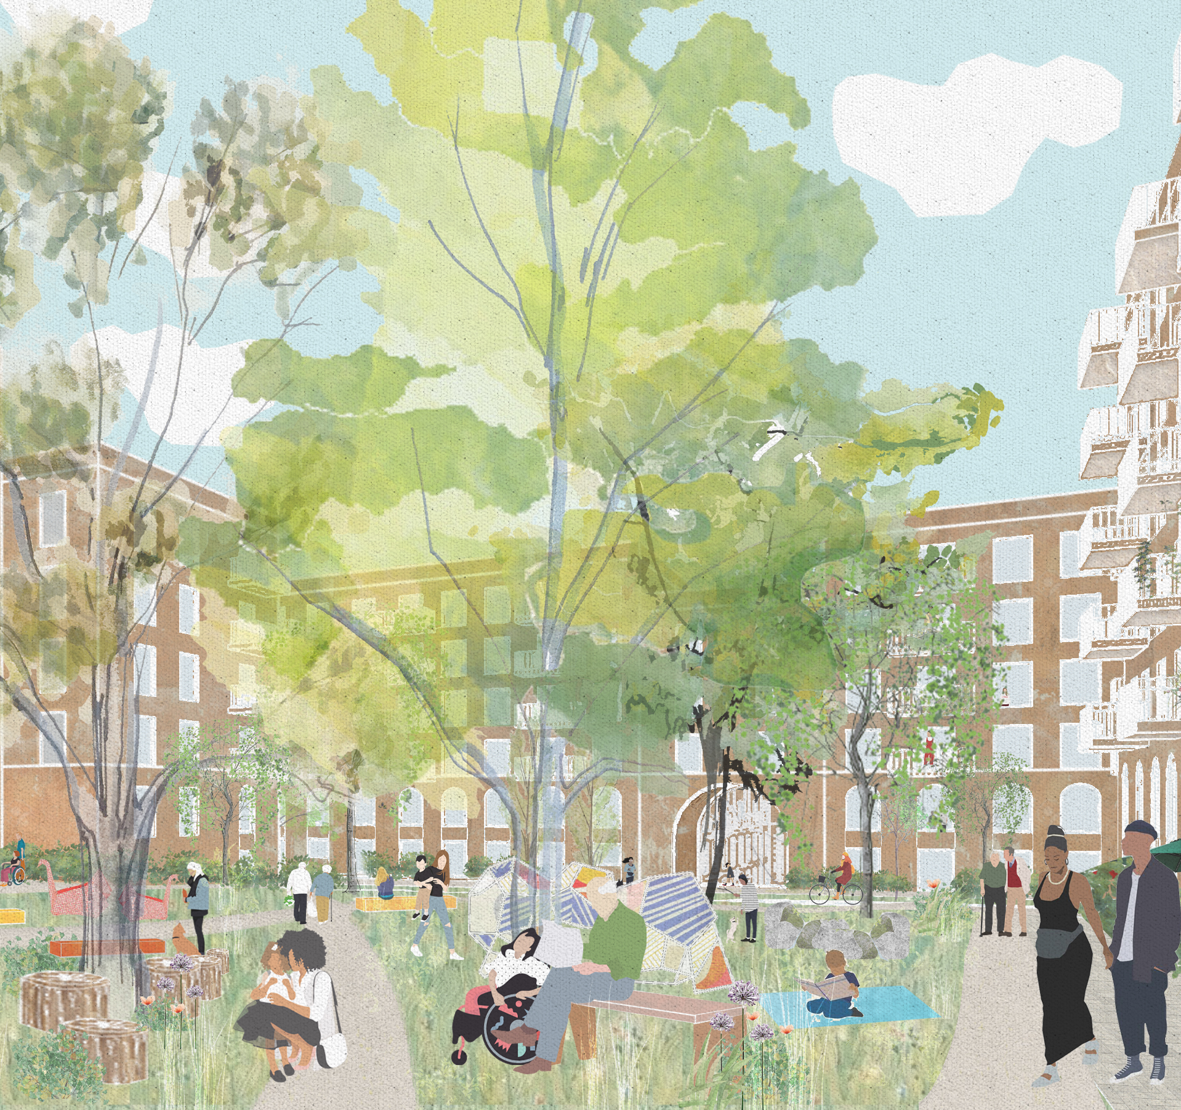
Barnsbury Leaseholder meeting
5 August 2021

Slide 2
Agenda
1 Introductions from Newlon 5 minutes
2 Service Charges and Section 20 25 minutes
3 Residents Charter 20 minutes
4 Old Barnsbury What is happening 30 minutes
5 New Barnsbury – What is happening 20 minutes
Questions – please put in chat, try to keep general

Slide 3

Intros – who is doing what at Newlon
Property | Development | Housing
Old Barnsbury works | New Barnsbury works | Decants and liaison
Symon Sentain | Ezinne Ogbonna | Bill Henderson
Jodie Desai Liaison Role (in due course) | Angela Nevin (from September) | Annette Morrison Jennifer Oppong Jane Cass
Other responsibilities | Other responsibilities | Other responsibilities
Repair contracts Asset management Fire safety Compliance | Sales and Resales | Local Office The Hall Service charges
Bit about Mount Anvil
JOINT VENTURE PARTNER – New Barnsbury – Mount Anvil

Slide 4
Service charges
Service charges are for services in connection with occupation of homes
Most HA tenants pay service charges too (but not for insurance, management or repairs/works)
Highly regulated and processes prescribed
Leaseholders pay for major works offset against sinking fund and the invoiced
The principle is that (for long leases) all Landlord costs are recoverable, but have to be reasonable and meet the law
Newlon is a long leaseholder too and pays service charges on about 3000 homes

Slide 5
Some sample monthly charges (March 21 numbers)
Address | Leaseholder | Tenant
Ewen House | £109 | £50
Berners House | £116 | £50
Phelps Lodge | £173 | n/a
Queensland Road | £196 | £140
Caledonian Road | £143 | £117
Ashburton | £170 | £140
What makes charges high?
Equipment
New Buildings
Complicated Buildings
Small buildings
Tall Buildings
Over specified services

Slide 6
Section 20 – both simple and complicated
Applies when works cost is over £250 or cost of a service is over £100 a year
5 types but similar
Works = repairs and sometimes improvements
Services = more or less anything else (cleaning, gardening, fuel)
Not a proper substitute for proper consultation
Doesn’t really control management of contracts e. g what repairs to actually do)
Protects rights but cumbersome and rarely elicits responses, except on Barnsbury
Care lots | Care a bit | Don’t care
Cleaning Gardening Security Works | Lifts Entryphones | Water Hygiene Energy Lightbulbs Pumps

Slide 7
Section 20 major works not requiring notice (under £5 million)
STEP ONE - NOTICE OF INTENTION
Make Observations
Nominate contractors
STEP TWO – DUTY TO CONSIDER
No time limit
STEP THREE –GIVE ESTIMATES AND RESPONSES TO OBSERVATIONS
Right to Inspect contract place and time given
Give Comments
STEP FOUR –CONSIDER AND RESPOND TO COMMENTS
21 days
STEP FIVE (ONLY IF NOT LOWEST TENDERER OR NOMINATED CONTRACTOR
NOTIFY OF APPOINTMENT AND REASONS
30 days
30 days
RESPOND TO COMMENTS
CAPITALS – LANDLORD
Lower case- payers
Red - timescales

Slide 8
Where Section 20 doesn’t apply
Under £250 per piece of works per resident/£100 a year for services
Service Contracts of less than a year if over £100
Directly employed staff
Contracts before tenancy/leases granted
Where exemption granted
Penalty for not following is restriction of costs to £250 Works or £100 a year Services, .
“exceptions” can be granted retrospectively but Newlon has never done this.

Slide 9
Why are you/is Barnsbury getting more Sections 20s
BELMO itself, though not its services, were exempt
Now part of larger contracts covering higher cost schemes elsewhere so if just on Barnsbury then
we might not have to do a Section 20
Expiry of some contracts
Seeking an exemption for Energy
Sometimes error. We should not have to or did not need to
Inflation: cost limits set a couple of decades ago
We would like to consult you more. Section 20 not the best way to do it.

Slide 10
2015 Gardening contract 1250 homes
What this shows that on a gardening
contract less than 10% of people fell
within the S20 limit of £100 a year
but all 1250 had to be consulted.
We got one reply.
The black star represents the cost
of gardening at Barnsbury which
we are not tendering. Most services
at Barnsbury fall beneath the £100
limit but because you might be part of a
bigger contract we send you letters

Slide 11
How Section 20 might work at Old Barnsbury
Consultation, consultation, consultation – before Section 20
Everyone will get Section 20 or Section 20s whether to be
charged or not. Process will be followed
These may be the sort of works here we do not choose lowest
Tender – quality counts
Everyone will get an invoice (within 18 months)
Deduction from Sinking fund (if paying)
Newlon will reach agreement with you regarding non payment
if you are eligible not to pay
Apportionments – by building if works to building. Communal on Old Barnsbury to
everyone on Old Barnsbury; no New to Old or Old to new costs

Slide 12
Problems
If followed to the letter is all on paper
Expensive for us
Allows “observations” and “comments” which must be “considered” and “replied to”
Is (broadly speaking) a rubbish way to ask people what they think about things
Strict compliance is difficult to define
Landlords and service charge payers get hung up on it. It is possible to get s20 perfectly correct but still have unhappy residents , an unhappy landlord, and even (obviously not at Newlon)a poor service.
But it does provide some protection to both landlord and payers

Slide 13
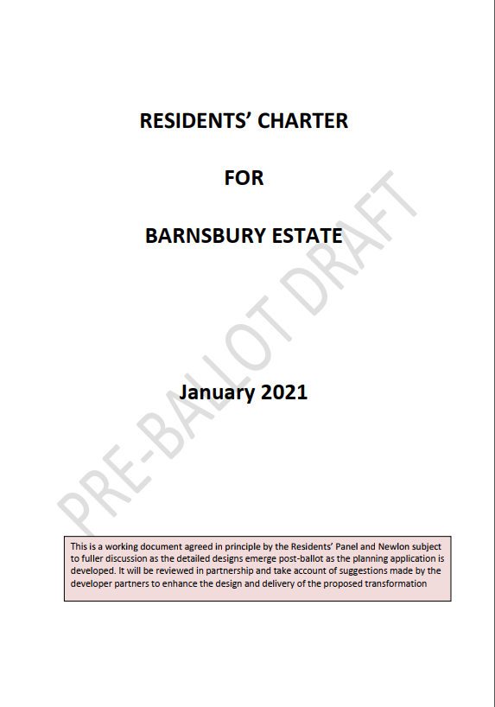
RESIDENTS CHARTER
Our commitment to residents. Expands on the Offer document
Reflects residents’ wishes but also our proposals
Should be reviewed annually
Is a dialogue
Wide ranging
Really important

Slide 14
Section 8 of charter –Old Barnsbury
Applies to Old Barnsbury
Non resident leaseholders charged up to £50,000
Resident leaseholders not charged, but if move out/sell then pay between 100
or 20%
How?
Everyone will be section 20ed
Everyone will be “charged” (i.e. an invoice sent)
We will not pursue the charge where people have agreed not to be charged.
Why?
We are spending money to make Barnsbury better for everyone, if you sell after getting free works then they are taking the money off the estate.
We are a charity
There is limited ability to spread costs or charges over time.
No invoices likely for three or four years

Slide 15
Residents Charter 3
Section 8 is half a page there are 18 and half other pages covering
Design
Choice
Involvement
Services
It is a great way for you to influence how we work for you

Slide 16
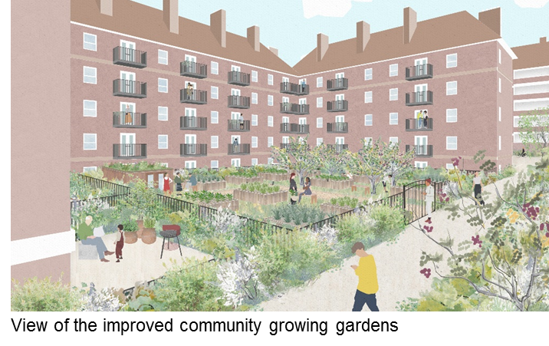
OLD BARNSBURY

Slide 17
OLD BARNSBURY REFURBISHMENT
Consultation, consultation, consultation…!
The Landlord Offer document promise - we will meet with you to discuss the refurbishment options
Range of choices - if you choose to buy into the scheme - including the layout of your kitchen and bathroom as well as fixtures, fittings, paint finish and flooring
Fantastic open/communal spaces to match New Barnsbury
Refurbishment will start on Old Barnsbury in line with construction starts on New Barnsbury
Estimate will be in 2023 and will be managed in phases to minimise disruption
Submitting a planning application to the Council for the estate transformation which will need to be agreed by their planning committee
Great opportunity to bring properties up to the standard of New Barnsbury – thermal performance and comfort, running costs and values

Slide 18
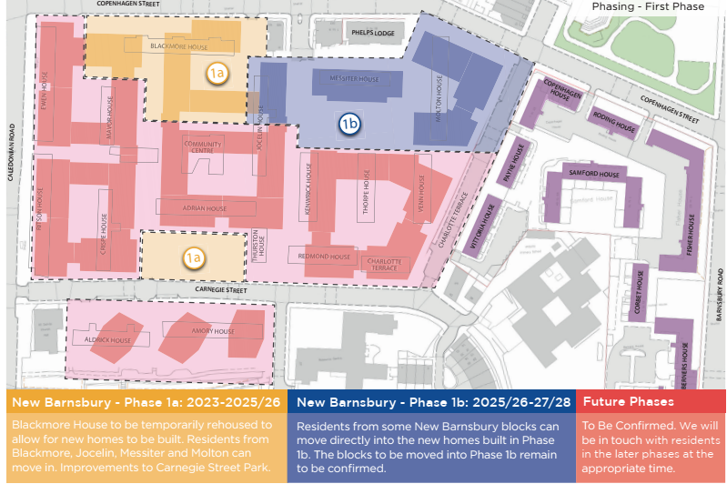
New Barnsbury
Blackmore first
18 months to “decant”
Then two plus years of works
Then Molton Messiter and
Jocelin

Slide 19
Why the new phasing
 | Adrian/Thurston | Blackmore
Duration of works for whole estate | 739 weeks | 486 weeks
Homes in first phase | 40 | 121
First social home | 93 weeks | 90 weeks
First private home | 287 weeks | 180 weeks

Slide 20
Shared Equity and Buy Backs
Will be overseen by our Sales and Resales Team, but not yet.
Shared Equity
you own a percentage of the new property and get the same percentage if sold later. Pay full service charges
Buy back
Choice from panel of valuers
Your own valuer if unhappy with that, an appeal if we cannot agree
Newlon meet wide range of costs including (capped) stamp duty on a new home if you are buying one
CPO if does not work out.
Early buy backs
Only if we really need the home, or in hardship, and not yet
Our priority is Blackmore and it is likely we will only buy back 3 to 4 (if that) by the end of 2021

Slide 21
Advice & Questions
Best@newlon.org.uk
carol@sourcepartnership.com rob@sourcepartnership.com
Source surgeries last Wednesday of month, but do call and they can visit.
Drop ins at the Hall – 11th 17th and 21st
Leasehold Advisory Service

