Slide 1

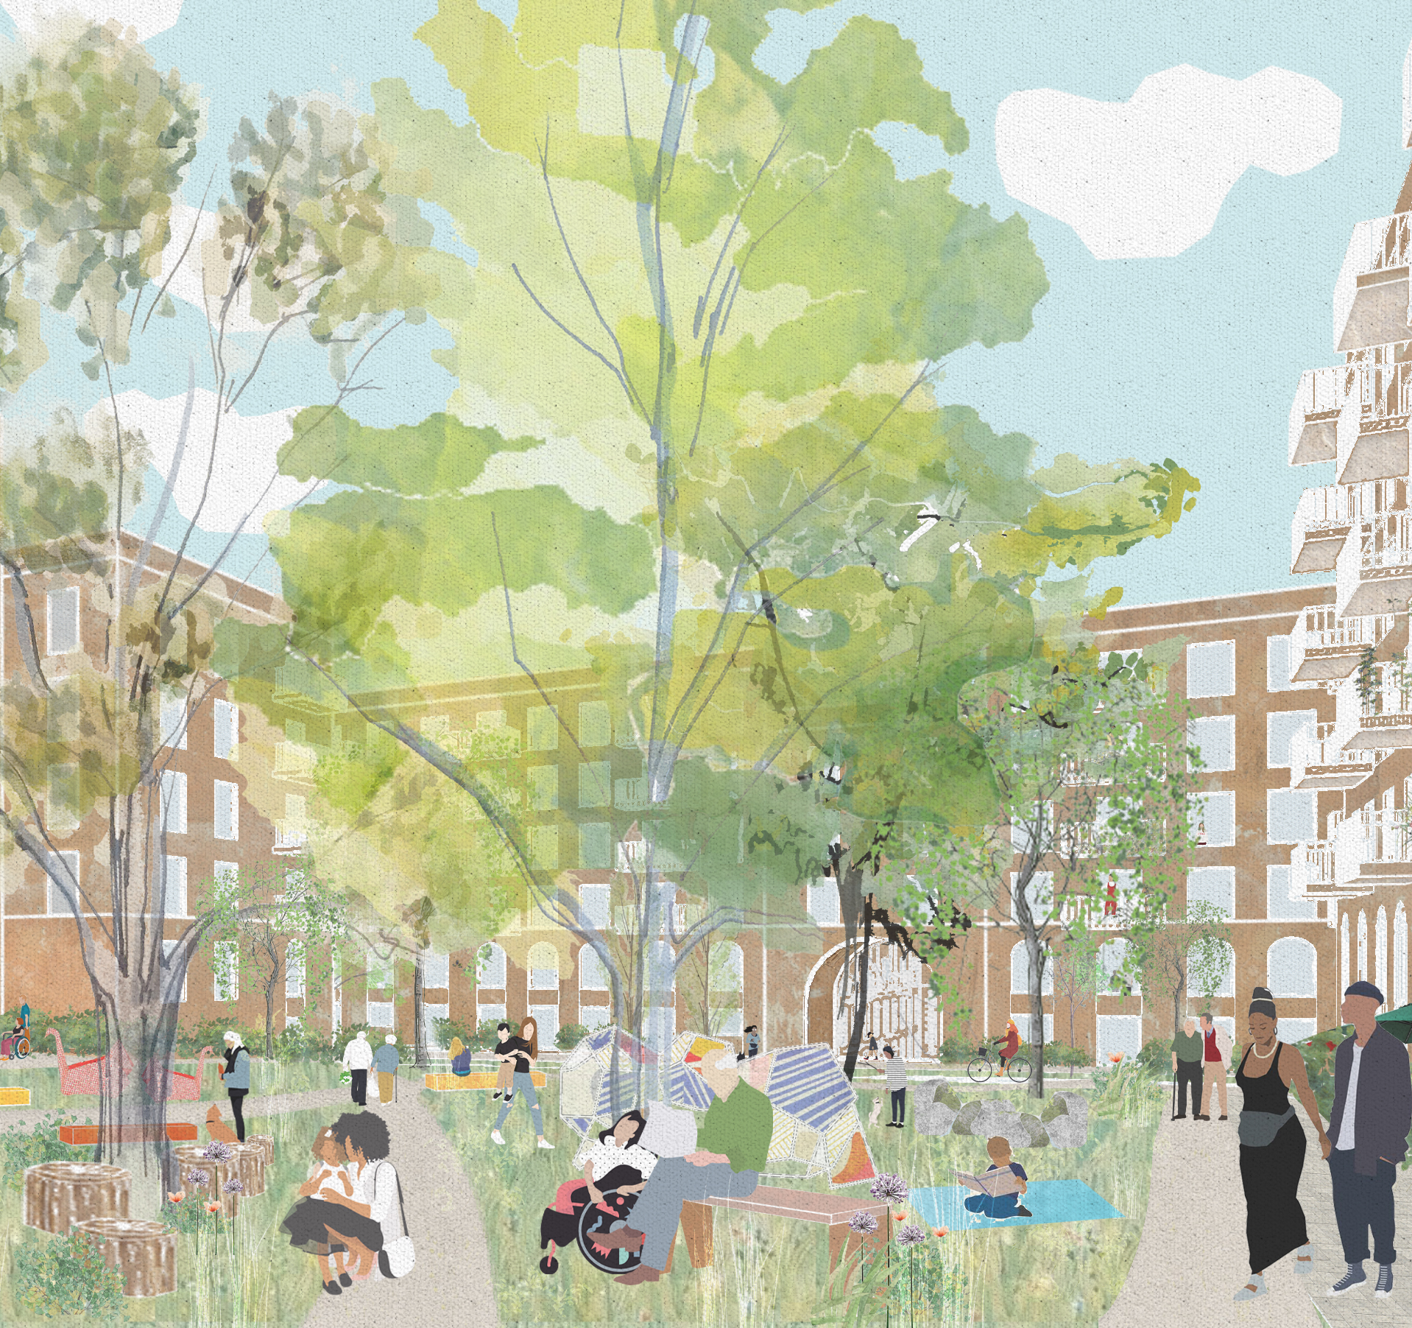
Residents’ Charter for Barnsbury Estate
16 September 2021

Slide 2
The Barnsbury Estate RESIDENTS CHARTER…
Is our* commitment to residents
Is an expansion on the Offer Document
Reflects residents’ wishes but also our proposals
Should be reviewed annually
Is a dialogue
Is wide ranging
*Newlon and development partners’

Slide 3
Residents Charter document includes details on:
Design
Choice
Involvement
Services
and… it is a great way for you to influence how we work with you

Slide 4
Overview
The Residents’ Charter is a working document agreed by residents and Newlon subject to monitoring and review as the detailed designs emerge post-ballot as the planning application is developed.
It will be reviewed in partnership and take account of suggestions made by the developer partners to enhance the design and delivery of the proposed transformation.
Source have consulted with residents (a Residents’ Panel, as well as a wider group of interested residents) and Newlon about the key elements of the Charter, and through these extensive consultation meetings have created the current version (dated January 2021).
The Charter was based on commitments that residents asked for and that Newlon agreed to.
Source can act as a point of information and channel these to Newlon.

Slide 5
Format/Purpose of the Charter
Neither the Offer Document or the Charter have a formal legal status.
Key principles from both documents could be enshrined in the Joint Venture agreement and contracts with service providers.
It is a guiding document relating to the Transformation of Barnsbury Estate.
The Charter will be included in the planning application as part of the Statement of Community Engagement.
The current version is the most up-to-date but is a living document so things can be added that are beneficial to both parties.
The Residents’ Group should put forward any requests to Newlon for additions. Newlon, Mount Anvil and contractors will, as needed, suggest more detail be added or additional commitments included.

Slide 6
Monitoring of the Charter
The Residents’ Group will monitor and track progress of the elements within the Charter.
Newlon Staff who are accountable for changes will include Sr Managers or Directors and other Newlon Staff representatives who are able to bring forward any suggestions or feedback to key staff.
Any changes must be agreed by Directors of Newlon Housing Trust and a majority of residents from the Residents’ Group, but for any significant changes or if there is anything that would contradict the Offer Document this would need a process for ensuring that wider residents across Barnsbury are informed and consulted.
One suggestion is to keep a 'log' of key commitments is set up so that residents can track using this and which is updated by Newlon staff.

Slide 7
Questions and engagement
Best@newlon.org.uk
carol@sourcepartnership.com / rob@sourcepartnership.com
Source surgeries are held on the last Wednesday of month - but do call and they can visit.
Information day organised by Mt Anvil and Newlon – was held on 15 September at the Community Centre (in addition to other information days held over the summer).
Upcoming Drop-in/Resident Consultation Workshops will be held in October, November, December, and January/February so that residents can engage with project team members to review and have input into design, masterplan, and the transformation process in advance of the Planning Application.

